Slide 1
Instructions for Making Decisions
MIPS assembly language includes two decision-making instructions, similar to an if statement with a goto
The first instruction is:
beq register1, register2, L1
This instruction means “go to the statement labeled L1 if the value in register1 equals the value in register2”
The mnemonic beq stands for branch if equal

Slide 2
Instructions for Making Decisions
The second instruction is:
bne register1, register2, L1
It means “go to the statement labeled L1 if the value in register1 does not equal the value in register2”
The mnemonic bne stands for branch if not equal
These two instructions are traditionally called conditional branches

Slide 3
if (i == j)
f = g + h;
else
f = g – h;
bne $s3,$s4,Else # go to Else if i ≠ j
The first expression compares for equality, so it would seem that we would want the branch if registers are equal instruction (beq)
In general, the code will be more efficient if we test for the opposite condition (bne)

Slide 4
if (i == j)
f = g + h;
else
f = g – h;
bne $s3,$s4,Else # go to Else if i ≠ j
add $s0,$s1,$s2 # f = g + h (skipped if i ≠ j)
j Exit # go to Exit
We now need to go to the end of the if statement
We introduce another kind of branch, often called an unconditional branch
This instruction says that the processor always follows the branch

Slide 5
if (i == j)
f = g + h;
else
f = g – h;
bne $s3,$s4,Else # go to Else if i ≠ j
add $s0,$s1,$s2 # f = g + h (skipped if i ≠ j)
j Exit # go to Exit
Else: sub $s0,$s1,$s2 # f = g – h (skipped if i = j)
Exit:

Slide 6
Notice that the assembler relieves the compiler and the assembly language programmer from calculating addresses for branches, just as it does for calculating data addresses for loads and stores
It’s the assembler to calculate the addresses of all the labels
Note that: Compilers frequently create branches and labels where they do not appear in the programming language.

Slide 7
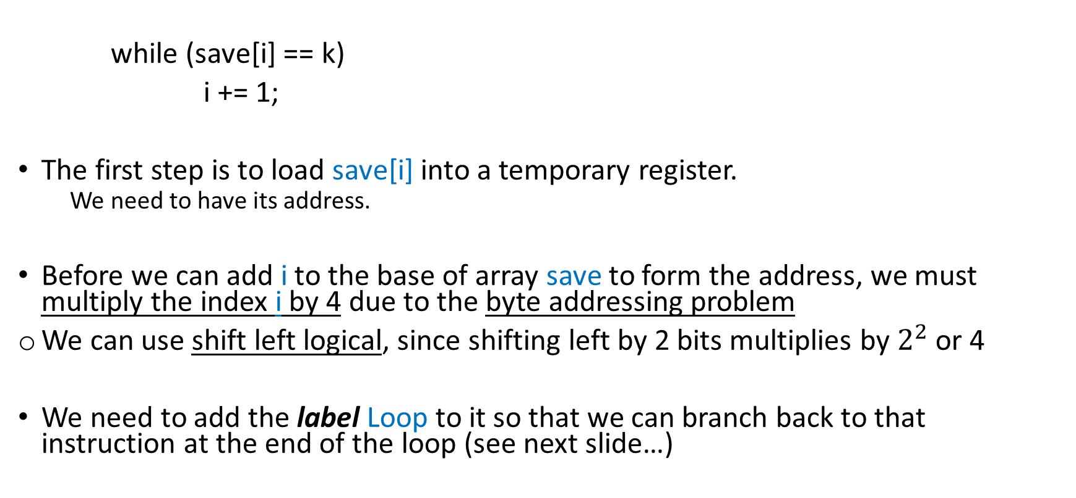
Loops
Assume that:
$s3 = i
$s5 = k
save (base address) = $s6
while (save[i] == k)
i += 1;
The first step is to load save[i] into a temporary register.
We need to have its address.
Before we can add i to the base of array save to form the address, we must multiply the index i by 4 due to the byte addressing problem
We can use shift left logical, since shifting left by 2 bits multiplies by $2^{2}$ or 4
We need to add the label Loop to it so that we can branch back to that instruction at the end of the loop (see next slide…)

Slide 8
Loops
Assume that:
$s3 = i
$s5 = k
save (base address) = $s6
while (save[i] == k)
i += 1;
Loop: sll $t1,$s3,2 # Temp reg $t1 = i * 4
add $t1,$t1,$s6 # $t1 = address of save[i]
lw $t0,0($t1) # Temp reg $t0 = save[i]
bne $t0,$s5, Exit # go to Exit if save[i] ≠ k
addi $s3,$s3,1 # i = i + 1
j Loop # go to Loop
Exit:

Slide 9
Loops
The test for equality or inequality is probably the most popular test, but sometimes it is useful to see if a variable is less than another variable
We’ll use an instruction in MIPS assembly language that compares two registers and sets a third register to 1 if the first is less than the second; otherwise, it is set to 0.
This MIPS instruction is called set on less than, or slt

Slide 10
Loops
slt $t0, $s3, $s4 # $t0 = 1 if $s3 < $s4
It means that register $t0 is set to 1 if the value in register $s3 is less than the value in register $s4; otherwise, register $t0 is set to 0
Constant operands are popular in comparisons, so there is an immediate version of the set on less than instruction.
To test if register $s2 is less than the constant 10, we can just write:
slti $t0,$s2,10 # $t0 = 1 if $s2 < 10

Slide 11
Loops
MIPS compilers use the slt, slti, beq, bne, and the fixed value of 0 ($zero) to create all relative conditions:
equal, not equal, less than, less than or equal, greater than, greater than or equal
NOTE:
The MIPS architecture doesn’t include branch on less than because it is too complicated;
It would stretch the clock cycle time
It would take extra clock cycles per instruction
Two faster instructions are more useful

Slide 12
Unsigned values
Comparison instructions must deal with the dichotomy between signed and unsigned numbers.
Sometimes a bit pattern with a 1 in the most significant bit represents a negative number and, of course, is less than any positive number, which must have a 0 in the most significant bit.
With unsigned integers, on the other hand, a 1 in the most significant bit represents a number that is larger than any that begins with a 0

Slide 13
MIPS offers two versions of the set on less than comparison to handle these alternatives
Set on less than (slt) and set on less than immediate (slti) work with signed integers
Whereas, unsigned integers are compared using set on less than unsigned (sltu) and set on less than immediate unsigned (sltiu)

Slide 14
-1ten if it is a signed integer
4,294,967,295ten if it is an unsigned integer
Suppose register $s0 has the binary number
1111 1111 1111 1111 1111 1111 1111 1111
And that register $s1 has the binary number
0000 0000 0000 0000 0000 0000 0000 0001
What are the values of registers $t0 and $t1 after these two instructions?
slt $t0, $s0, $s1 # signed comparison
sltu $t1, $s0, $s1 # unsigned comparison
1ten in either case

Slide 15
-1ten if it is a signed integer
4,294,967,295ten if it is an unsigned integer
Suppose register $s0 has the binary number
1111 1111 1111 1111 1111 1111 1111 1111
And that register $s1 has the binary number
0000 0000 0000 0000 0000 0000 0000 0001
Then register $t0 has the value 1, since -1ten < 1ten, and register $t1 has the value 0, since 4,294,967,295ten > 1ten
slt $t0, $s0, $s1 # signed comparison
sltu $t1, $s0, $s1 # unsigned comparison
1ten in either case

Slide 16
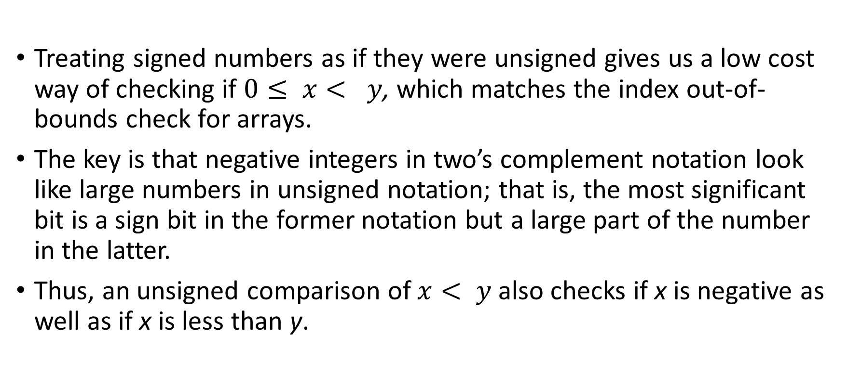
Bounds Check Shortcut
Treating signed numbers as if they were unsigned gives us a low cost way of checking if $0≤ x< y$, which matches the index out-of-bounds check for arrays.
The key is that negative integers in two’s complement notation look like large numbers in unsigned notation; that is, the most significant bit is a sign bit in the former notation but a large part of the number in the latter.
Thus, an unsigned comparison of $x< y$also checks if x is negative as well as if x is less than y.

Slide 17
Bounds Check Shortcut
Use this shortcut to reduce an index-out-of-bounds check:
jump to IndexOutOfBounds if $s1 ≥ $t2 or if $s1 is negative
The checking code just uses u to do both checks:
sltu $t0,$s1,$t2 # $t0=0 if $s1>=length or $s1<0
beq $t0,$zero,IndexOutOfBounds #if bad, goto Error

Slide 18
Case Switch Statement
Most programming languages have a case or switch statement that allows the programmer to select one of many alternatives depending on a single value.
The simplest way to implement switch is via a sequence of conditional tests, turning the switch statement into a chain of if-then-else statements
Sometimes the alternatives may be more efficiently encoded as a table of addresses of alternative instruction sequences, called a jump address table or jump table
The program needs only to index into the table and then jump to the appropriate sequence.

Slide 19
Case Switch Statement
The jump table is then just an array of words containing addresses that correspond to labels in the code.
The program loads the appropriate entry from the jump table into a register.
It then needs to jump using the address in the register.
To support such situations, computers like MIPS include a jump register instruction (jr), meaning an unconditional jump to the address specified in a register.
Then it jumps to the proper address using this instruction.

Slide 20
Procedures
In the execution of a procedure, the program must follow these six steps:
Put parameters in a place where the procedure can access them.
Transfer control to the procedure.
Acquire the storage resources needed for the procedure.
Perform the desired task.
Put the result value in a place where the calling program can access it.
Return control to the point of origin, since a procedure can be called from several points in a program.

Slide 21
■ $a0–$a3: four argument registers in which to pass parameters
■ $v0–$v1: two value registers in which to return values
■ $ra: one return address register to return to the point of origin
In addition to allocating these registers, MIPS assembly language includes an instruction just for the procedures:
The jump-and-link instruction (jal) is simply written:
jal ProcedureAddress
It does 2 things: It jumps to an address and simultaneously saves the address of the following instruction in register $ra

Slide 22
To support the jump to a specified address, MIPS uses jump register instruction (jr), to jump to the address specified in a register:
jr $ra
The jump register instruction jumps to the address stored in register $ra
The calling program, or caller, puts the parameter values in $a0–$a3 and uses jal X to jump to procedure X (callee)
The callee then performs the calculations, places the results in $v0 and $v1, and returns control to the caller using jr $ra

Slide 23
Implicit in the stored-program idea is the need to have a register to hold the address of the current instruction being executed.
For historical reasons, this register is almost always called the program counter, abbreviated PC
Although a more sensible name would have been instruction address register.
The jal instruction actually saves PC + 4 in register $ra to link to the following instruction to set up the procedure return.

Slide 24
Procedures – More registers!
Suppose a compiler needs more registers for a procedure than the four argument and two return value registers.
Any registers needed by the caller must be restored to the values that they contained before the procedure was invoked.
The ideal data structure for spilling registers is a stack—a last-in-first-out queue (LIFO)
A stack needs a pointer to the most recently allocated address in the stack to show where the next procedure should place the registers to be spilled or where old register values are found
The stack pointer is adjusted by one word for each register that is saved or restored. MIPS software reserves register 29 for the stack pointer, giving it the obvious name $sp

Slide 25
Procedures – More registers!
Placing data onto the stack is called a push, and removing data from the stack is called a pop
low
address
text
By historical precedent, stacks “grow” from higher addresses to lower addresses
This convention means that you push values onto the stack by subtracting from the stack pointer.
Adding to the stack pointer shrinks the stack, thereby popping values off the stack.
data
heap
↓
↑
stack
pointer (SP)
stack
high
address

Slide 26
Example
leaf_example:
addi $sp, $sp, –12 # adjust stack to make room for 3 items
sw $t1, 8($sp) # save register $t1 for use afterwards
sw $t0, 4($sp) # save register $t0 for use afterwards
sw $s0, 0($sp) # save register $s0 for use afterwards
add $t0,$a0,$a1 # register $t0 contains g + h
add $t1,$a2,$a3 # register $t1 contains i + j
sub $s0,$t0,$t1 # f = $t0 – $t1, which is (g + h)–(i + j)
add $v0,$s0,$zero # returns f ($v0 = $s0 + 0)
lw $s0, 0($sp) # restore register $s0 for caller
lw $t0, 4($sp) # restore register $t0 for caller
lw $t1, 8($sp) # restore register $t1 for caller
addi $sp,$sp,12 # adjust stack to delete 3 items
jr $ra # jump back to calling routine
int leaf_example(int g, int h, int i, int j)
{
int f;
f = (g + h) – (i + j);
return f;
}
$a0 $a1 $a2 $a3
$s0 $t0 $t1
$v0
Notes:
The parameter variables g, h, i, and j correspond to the argument registers $a0, $a1, $a2, and $a3, and f corresponds to $s0

Slide 27
In the previous example, we used temporary registers and assumed their old values must be saved and restored.
To avoid saving and restoring a register whose value is never used, which might happen with a temporary register, MIPS software separates 18 of the registers into two groups:
$t0–$t9: temporary registers that are not preserved by the callee (called procedure) on a procedure call
$s0–$s7: saved registers that must be preserved on a procedure call (if used, the callee saves and restores them)
Notes:
This simple convention reduces register spilling.

Slide 28
Nested Procedures
Suppose that the main program calls procedure A with an argument of 3, by placing the value 3 into register $a0 and then using jal A
Then suppose that procedure A calls procedure B via jal B with an argument of 7, also placed in $a0
Since A hasn’t finished its task yet, there is a conflict over the use of register $a0
Similarly, there is a conflict over the return address in register $ra, since it now has the return address for B

Slide 29
Nested Procedures
One solution is to push all the other registers that must be preserved onto the stack, just as we did with the saved registers
The caller pushes any argument registers ($a0–$a3) or temporary registers ($t0–$t9) that are needed after the call
The callee pushes the return address register $ra and any saved registers ($s0–$s7) used by the callee
The stack pointer $sp is adjusted to account for the number of registers placed on the stack
Upon the return, the registers are restored from memory and the stack pointer is readjusted

Slide 30
